Slide 1
Care Support and Enablement
Provider Engagement Event
25th September 2017
Adult Social Care & Strategic Commissioning

Slide 2
Care Support and Enablement
Provider Engagement Event - 25th September 2017
Welcome and Introductions
Adult Social Care Overview & Vision
CSE Current Position – Evidence for Change
Vision CSE
Commissioning for Outcomes Model/Process
Transitions Model – Sharon Ribeiro -
Procurement – Accredited Provider List

Slide 3
Adult Social Care
Better Lives Better Outcomes
Within Adult Social Care a principle is emerging that a life independent of services and social care intervention is a better one than a life dependant on statutory support
However Adult Social Care do also recognise that some people will need services and interventions to enable them to live their life, but these services should be outcome focussed and promote independence.

Slide 4
Learning Disability
Move towards the “Progression” model where citizens are encouraged towards more independent living
Care and Support plans will identify outcomes a citizen wants to achieve (these could range from making a simple meal, independently getting dressed, accessing local universal services such as clubs, swimming pools or independently using public transport)
The new Care Support and Enablement Model will have the expectation that providers will support citizens to achieve these outcomes encouraging independence wherever possible

Slide 5
Learning Disability
Errol has a learning disability and autism. He lives at home with his elderly father.
Traditional services. Errol attend day services five days a week. He is transported there by social services funded transport.
Better lives/ Better outcomes. Errol’s father dies and he moves to residential care, but only briefly as he moves to supported living with some old friends from the day center. Errol has identified as his outcomes that he wants to travel independently and gain paid employment in a shop. Errol is given travel training and succeeds in being able to use the bus independently to travel to several destinations. He was to supported to complete a placement in a Charity shop and is now receiving support to find paid employment.

Slide 6
Mental Health
Embed the “Recovery” model to support citizens to live with their illness and develop insight into what may drive / trigger their condition and facilitate them to create an appropriate network of support .
Care and Support plans will identify outcomes a citizen wants to achieve this could include seeking paid employment, making friendships in their local community or independently undertaking meaningful day time activity
The new Care Support and Enablement Framework will have the expectation that providers will support citizens to achieve these outcomes encouraging independence wherever possible

Slide 7
Mental Health
Sabrina has an enduring mental illness with a number of positive symptoms. She is currently unemployed, living alone and has had several recent admissions to hospital. She has significant debts and is at risk of loosing her tenancy.
Traditional services. Sabrina receives 10 hours of Care, Support and Enablement this focuses on taking her out and supporting with finances
Better lives/ Better outcomes. Sabrina receives 10 hours of Care, Support and Enablement. Sabrina wants to be able to manage her finances better and make friendships in the local area. Sabrina is supported to attend a local college where she successfully completes a basic maths course which enables her to manage her money better. As a result of this Sabrina is able to afford to join a local community dancing group. Through being supported to attend this group Sabrina begins to make friendships in the local area. Six months later Sabrina has had no further hospital admissions.

Slide 8
Rationale for Change
CSE – Primary Support Reason
PSR = Primary Support Reason –
Main reason that a care package is given
Notes:
LD & MH highest users of CSE Services
MH was previously unavailable on the framework and has increased, and is due to increase because vision moving people from Long-term accommodation where appropriate into CSE, not residential
For 2020 predicted increase of 200 people
By 2030 – people aged 16-64yrs predicted to have a common MH Disorder 35,318
We know this will increase
LD
Adults with learning disabilities have greater and more complex health needs than the general population, and often these needs are not identified or treated. Following the Confidential Inquiry into Deaths of People with Learning Disability in the Bristol area a national mechanism for monitoring deaths is being developed by NHS England with local partners, to be implemented by CCGs from 2017.
The proportion of annual health checks at GP practices is variable and many people do not receive a full check or action plan.
Obesity and overweight are disproportionately high in the LD population
Confidential Inquiry there are likely to be unmet health needs and preventable early deaths in people with LD.

Slide 9
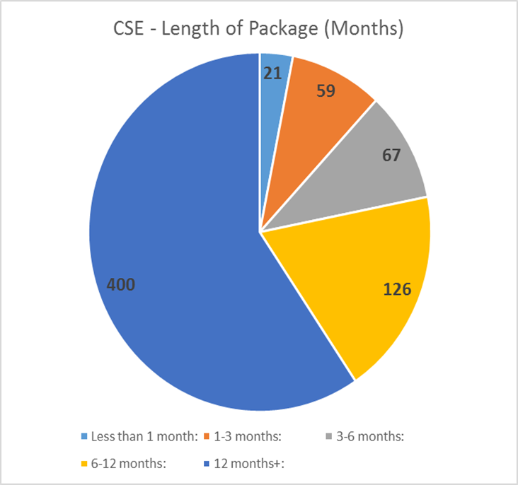
Evidence for Change
% Providers utilised Incentivised Enablement Model;
Lack of evidence demonstrating service impact or personal outcomes
Number of people receiving CSE is increasing
Framework of providers still resulted in use of SPOT

Slide 10
Evidence for Change
Price/Cost
Range of costs for CSE £13.40 up to £21
LA Comparative costs range £13.44 to £15
Standard and Complex services undefined resulting in variety of costs

Slide 11
Evidence for Change
Policy Change
Care Act 2014
National Minimum Wage impact Sleep-In
Transforming Care (2014)
Building the Right Support (2015)
Quality Monitoring and Reviews
Equality and Diversity (e.g. underrepresented groups are catered for)
Citizens are enabled to engage in activities of their choice
Citizens are supported to access the wider community

Slide 12
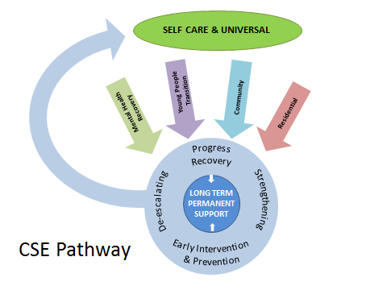
CSE Vision
Accredited Provider List
Outcome focussed approach
  Recovery and
  Progression Model

Slide 13
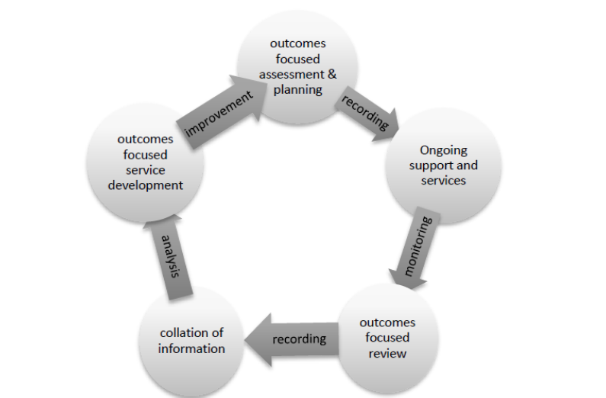
Commissioning for Outcomes
Notes:
This model will be dependent on clear roles and responsibilities:
Care Manager will establish outcomes and agree SMART plan with accredited CSE provider – Start and end dates
Responsibility will be on the provider to notify unmet outcomes before the end date with evidence
(Use the draft Outcomes table to explain)

Slide 14
Key Messages
Outcomes Approach
SMART Outcomes “Progression & Recovery”
Start and end date for services
Range Outcomes Tools
Defining Enhanced need
Pricing model harmonised

Slide 15
CSE Accreditation process
                An open Application Process is anticipated to commence towards the end of October 2017.
A straight forward application form has been developed to ensure the accreditation process is not onerous. Most of the questions will be Yes and No answers. The following question will be included:-
Which LOT(S) you wish to apply for
How you will meet the requirements of the service specification
Basic details of your organisation

Slide 16
CSE Accreditation process continued
Details of your current provision in the City and current contracts
Insurance levels
Financial details
Health & Safety details
Safeguarding vulnerable people polices
Care Quality Commission registration (for personal care)
Office location
Business continuity plan

Slide 17
CSE Accreditation process continued
                The process will be managed through the Due North Electronic Procurement System – Registration - www.eastmidstenders.org
You will need to download the documents from the portal and follow the instructions carefully
                All questions to go through the Due North system during the accreditation period
                Applications will be scored according to the stated criteria. If successful, a contract will be issued. Take care when completing questions as some are “eliminate” questions
                Return completed Application by the stated deadline through Due North

Slide 18
CSE Accreditation process continued
                The Accreditation will be open for duration of the contract (initially 5 years) so providers can join at any time
                If unsuccessful, feedback will be provided on request
                Opportunity to reapply if unsuccessful in the first instance provided that the reason for elimination has been ratified
                The process will fit alongside a review of all packages. There will be no guarantee of business going forward
                An Expression of Interest form will be used for the call-off of individual packages
                There will be NO contracting outside of the accredited list of providers

Slide 19


Slide 20

Next Steps…
New framework will be commissioned 2018
Any further feedback or comments email MBP@nottinghamcity.gov.uk
Thank you for coming

Slide 21
Contacts
Linda Sellars (Director Quality & Change)
Steve Oakley (Head of Contracting & Procurement)
Sharon Bramwell (Lead Commissioning Manager)
Julie Herrod (Lead Procurement Officer)
Sharon Ribeiro (Lead Contracts Manager)

