Slide 1


Nottingham City Council Community Cohesion & Hate Crime Grants 2026-27
Notes:
Introduce the session and myself
Nottingham City Council intro - Hester

Slide 2

What we will cover
Background of Community Cohesion & Hate Crime Grants
Aims of CC & HC Grants
Who can apply and what for
CC & HC Grants application forms
Final Tips
Notes:
Reminder of why we are here
And what we will cover

Slide 3
What does community cohesion
mean to you?
Break you into small groups 3-4 for you to discuss
Come and feedback in 10 minutes
Notes:
Ice-breaker, groups talk to each other
Highlights difficulty in defining cohesion – important to make it clear in your application
More than just bringing people together and hoping.

Slide 4
Background of CC & HC Grants
Funding is in response to the significant and widespread disorder which led to negative behaviours within local communities in 2024, and comes from the Ministry of Housing, Communities and Local Government (MHCLG)
The purpose of the grant programme is to:
Reduce the risk of further public disorder in the future
Rebuild social trust and promote cohesion between communities

Slide 5
Background of CC & HC Grants
The impact of the grants programme and any grants made are to:
Improve community cohesion and understanding between individuals, communities and groups from different backgrounds, beliefs and cultures in Nottingham City
Reduce the risk of hate crime, micro-aggressions and radicalisation

Slide 6
Background of CC & HC Grants
Last year Nottingham City Council made:
1 Large grant – Nottingham More in Common Partnership (Communities Inc, Renewal Trust, NCVS, Jo Cox Foundation, NTU)
11 Medium grants
11 Small grants
Current grantees cannot apply, looking to build upon and encourage applications from other organisations

Slide 7
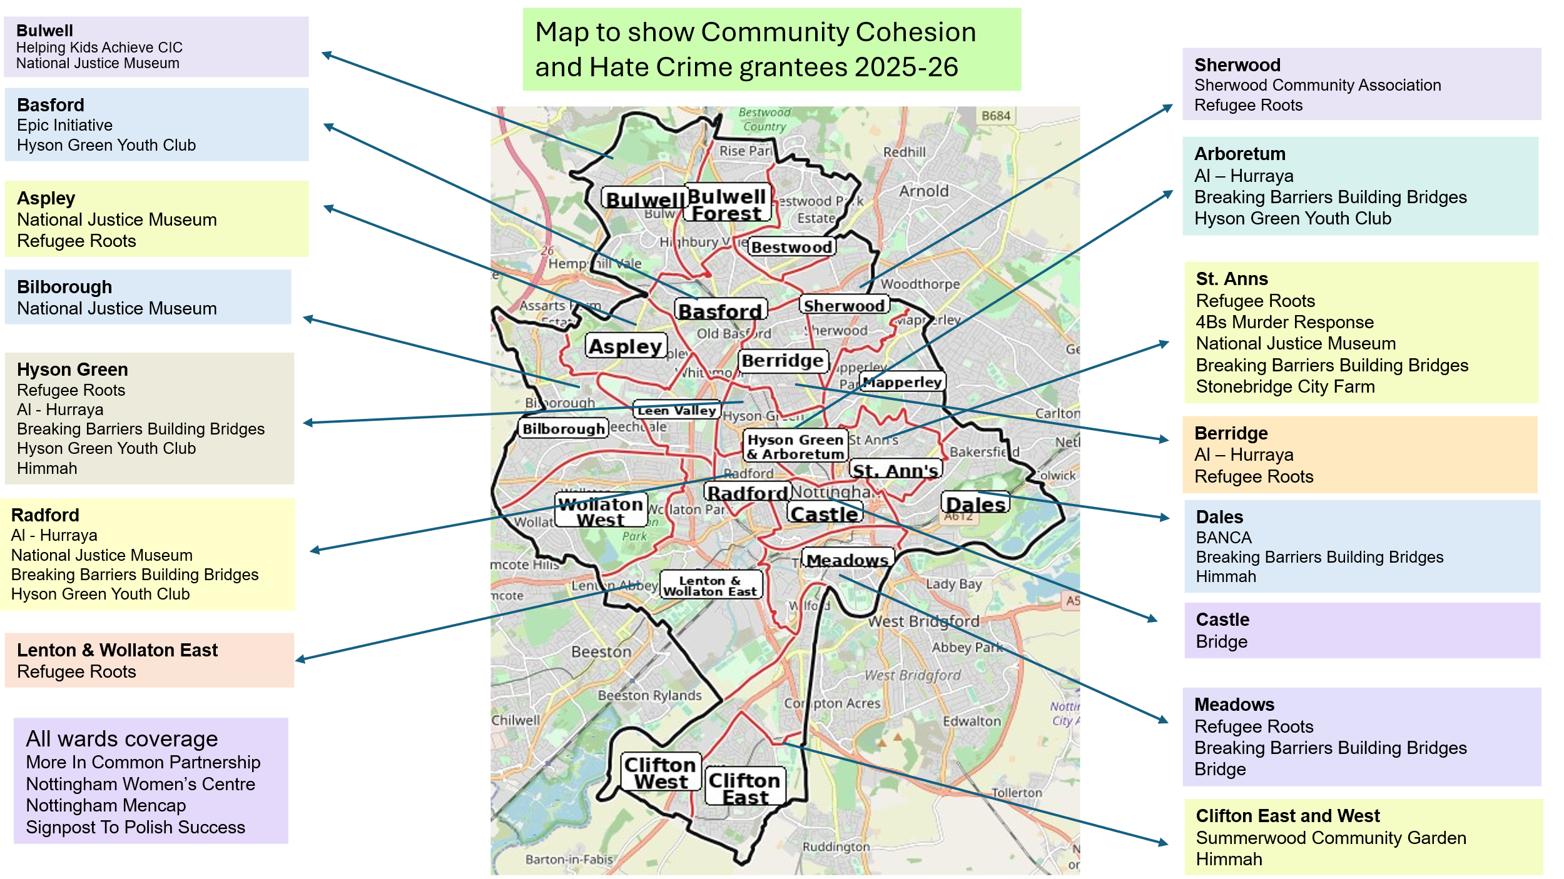

Slide 8
Background of CC & HC Grants
Additional priorities for this round:
Projects working in the Aspley, Clifton, Bulwell, Bestwood, Meadows, Broxtowe and Wollaton wards
Projects engaging White British men, women and young people
These groups are currently under-represented within this funding stream

Slide 9
Aims for CC & HC Grants
7 Aims overall
Your project must meet at least 1
Rebuild social trust and promote cohesion between communities
Increase equity and inclusion
Increase community engagement, participation, and a sense of belonging
Notes:
Check – Any questions on these?

Slide 10
Aims for CC & HC Grants
Increase and promote positive relationships between people from different backgrounds
Increase safety and respect for individuals and communities
Challenge and reduce prejudice, discrimination, stereotypes and myths
Build partnerships with the aim to work collectively on projects
Notes:
Check – Any questions on these?

Slide 11
CC & HC Grants – Who can apply
Not for profit organisations and groups that operate within the Nottingham City boundary, and must:
have governing doc. with dissolution clause/asset lock
have Bank/Building society account in organisations name
produce Accounts or Income & Expenditure sheets
Have a strong history of delivering community-based initiatives
Partnerships are fundable, but one organisation must have overall responsibility for management and delivery of the grant

Slide 12
CC & HC Grants – Who can apply
Policies and procedures in needed for all grants:
Constitution / Governing document
Accounts / Income & Expenditure sheets
Safeguarding CYP and Adults
EDI policy or statement
Medium grants also need:
Workplace Health and Safety policy
Modern Slavery statement
Privacy statement

Slide 13
CC & HC Grants – What you can apply for
Rent – To deliver your project or hire a venue for workshops, events
Equipment/Materials – Hire or purchase for project or events
Publicity – Leaflets, newsletter, social media to advertise the activities
Training – Training and courses that for volunteers/staff
Administration costs – Support for running the activities
Salaries – Staffing costs for additional hours / new posts / sessional workers to deliver the activities
Expenses – Travel / parking and other expenses for staff and volunteers delivering activities
Language support – Translation and interpreting costs

Slide 14
CC & HC Grants – What you cannot apply for
Individuals
Activities where making profit is a primary aim
Activities where the primary purpose is to promote religious beliefs or where people are excluded on religious grounds
Political groups or groups promoting political activities
Fund-raising activities
Groups / organisations where most of the membership live outside the Nottingham City Council boundary

Slide 15
CC & HC Grants – What you cannot apply for
Activities that take place outside the Nottingham City Council boundary other than in exceptional cases
Costs you owed or promised to pay before your application was approved i.e. retrospective costs
Projects and activities that will take more than 12 months to complete
Grant making bodies applying for funding to redistribute to individuals or groups
Costs associated with foreign travel

Slide 16
CC & HC Grants – What you can apply for
2 levels of grant:
- Medium – Grants up to £7,500 for up to 1-year
- Small – Grants up to £1,500 for up to 1-year
Can apply for both, but can only receive 1 grant
Go for the grant that fits with what you want to do

Slide 17
CC & HC Grants – Examples of £1,500 grants
A sports club wanting to run a community tournament or activity that will bring together people from different cultures, faiths or areas of Nottingham
A luncheon club welcoming new people into their community
Two or more organisations coming together to run a multicultural celebration
An organisation wanting to run a Hate-Crime awareness session
A community organisation delivering online safety training for parents, children and young people highlighting dangers extreme online views
Notes:
Starting the process – getting people together initially
Piloting or trying something new

Slide 18
CC & HC Grants – Examples of £7,500 grants
A group or partnership wanting to run a series of activities to exchange cultural experiences, challenge myths and stereotypes
A collaboration of community organisations which runs campaigns to increase awareness of hate crime, how to be an ally and the importance of reporting hate crimes and incidents
Sports clubs who wish to work with young people in schools and community settings to address prejudice and build understanding between different groups
A group which wishes to develop and deliver training on early signs of radicalisation and/or other extremist mindsets
Notes:
Got people together, now what?

Slide 19
Any questions?
Notes:
Does anyone feel like their project might not fit?

Slide 20
CC & HC Grants – 1-to-1 support
20-minute 1-to-1’s being offered
Opportunity to talk through your project and get advice and feedback on this
1-to-1 sessions taking place on:
Tuesday 3rd March – 1pm – 4pm
Wednesday 4th March – 10am – 1pm
Not able to review your actual application – can’t read a draft

Slide 21
Break
Notes:
21

Slide 22
CC & HC Grants application form
Must use and complete the CC & HC Grants application form – separate forms for Small and Medium Grants
Application is a word document – can copy into
Word counts detailed on the form – check before submitting
Checklist at the end of the form – check before submitting
Email the form and all required documents in one, make sure everything is attached
Submit your applications to: community.cohesion@nottinghamcity.gov.uk

Slide 23
Section 1 – About your organisation/group
Contact details
Registrations and reference/registration numbers
Where you work in Nottingham – which wards?
Ward map: Council Wards and Ward Maps - Nottingham City Council
Names and addresses for Chair, Treasurer and Secretary

Slide 24
Section 2 – Your plan and impact
7 questions for Medium grants
6 questions for Small grants
Q2.1 - Which wards in Nottingham city do you plan to work in/work with people from?
Q2.2 - How many people will benefit from this project / activity?

Slide 25
Section 2 – Your plan and impact
Q2.3 - Which communities (e.g. communities of place, religion, ethnicity, disability, sexual orientation, interest etc.) will you engage with to improve community cohesion and develop strong and positive relationships? (300 words)
Who is it you will be working with and supporting
Be specific and clear on who
Can include multiple groups, spell this out clearly
Highlight why you are bringing people together
Focus on the communities, not your project activities yet

Slide 26
Section 2 – Your plan and impact
Q2.4 - Please provide details of the events or activities you are proposing to deliver using this grant funding and refer to at least one of the following – grant aims (600 words)
Tell us about the delivery – activities, events, what you will do
Be as specific as possible – timings, how long for, etc.
Explain how these activities will bring about community cohesion, or reduce hate crime – don’t assume
More than bringing people together – explain that next step
Detail how it meets the programme aims – must meet at least 1
Better to meet 1-2 aims well rather than trying to meet many

Slide 27
Section 2 – Your plan and impact
Q2.4 – Through the grant we will hold a series of events inviting community groups from a range of different cultures and backgrounds. We are working with the local community church, refugee project, youth project and arts organisation.
The 7 events will be run on a Saturday afternoon once per month from April – October 2026 (when the weather and conditions are better at the allotment). Through these we will build links with the different community organisations and communities, bringing them into the allotment space so that they can then join us. The project will directly:
support and promote community cohesion
increase community engagement
promote positive relationships between communities
build partnerships for the future

Slide 28
Section 2 – Your plan and impact
Q2.4 – Through the grant we will hold a series of events inviting community groups from a range of different cultures and backgrounds. We are working with the local community church, refugee project, youth project and arts organisation.
The 7 events will be run on a Saturday afternoon once per month from April – October 2026 (when the weather and conditions are better at the allotment). Through these we will build links with the different community organisations and communities, bringing them into the allotment space so that they can then join us. The project will directly:
support and promote community cohesion
increase community engagement
promote positive relationships between communities
build partnerships for the future
Notes:
Range of cultures – who – name them specifically
Church, refugee project – name the organisations
Saturday – can you state exactly when and how long – could be 2 hours, could be 5-6 – big difference
Allotment – where, repeat here
Build links – how and for what purpose
Bringing people into the allotment space – for what purpose
Programme Aims – stated they will but not evidenced – need much more to justify this
116 words out of 600

Slide 29
Section 2 – Your plan and impact
Q2.5 - Please describe the impact this project will make i.e. what is the difference this project will make to the lives of the people you will work with? (200 words)
What difference for people and the and wider community
Highlight and talk about what this means on the ground
Link back to the programme aims - what will achieving the aim mean for people and your community
Make sure that this is realistic

Slide 30
Section 2 – Your plan and impact
Q2.5 – The project will support community members across Radford bringing them together to share an interest in gardening, allotments and growing.
Through this we will learn about each others culture including foods and celebrations. Increasing this understanding will help people to build and understand each other and reduce community tensions.

Slide 31
Section 2 – Your plan and impact
Q2.5 – The project will support community members across Radford bringing them together to share an interest in gardening, allotments and growing.
Through this we will learn about each others culture including foods and celebrations. Increasing this understanding will help people to build and understand each other and reduce community tensions.
Notes:
Sounds nice – so what? And?
How? – Is this fully detailed in the project activities, not really - go back and explain it.
Which communities, what community tensions – all need to be fully explained.
How will the project reduce community tensions?
Is this engaging those that it needs to? Or is it attracting those already on board.
49 words out of 200

Slide 32
Section 2 – Your plan and impact
Q2.6 - Please describe your organisation’s track record of successfully managing similar projects, including which groups and communities you have worked with in the past, how many people you have supported and the difference your work made. (max 500 words)
Want to see you can do this – reach the people, communities and numbers you have detailed
Highlight previous projects – talk about your successes
How you track change – how do you know it was a success
Include how you manage projects and grants of this size – include staff and volunteer skills and experience

Slide 33
Section 2 – Your plan and impact
Q2.6 – We have managed a number of grant funded projects from the city council and lottery sources in the last 2-3 years. Through these we have developed the allotment site and been able to increase our regular users from 15 up to 50 per week, and increased our volunteers from 5 to 12. This will be our first joint project with other community groups.

Slide 34
Section 2 – Your plan and impact
Q2.6 – We have managed a number of grant funded projects from the city council and lottery sources in the last 2-3 years. Through these we have developed the allotment site and been able to increase our regular users from 15 up to 50 per week, and increased our volunteers from 5 to 12. This will be our first joint project with other community groups.
Notes:
Size of grants maybe – helps to explain scale of projects and project management
Good increase – but who?
Nothing about the communities and their reach, or ability to engage.
Clearly a Comm Cohesion project – need to show links and ability to bring people together and those next steps
No details of managing tensions, difficult situations
If hate crime, and bringing communities together – we need to be confident you can manage this
How they will manage the partnership? Finances, delivery, etc.
What experience/expertise are the partners bringing?
63 out of 500 words

Slide 35
Section 2 – Your plan and impact
Question for Medium grants only
Q2.7 - What risks do you envisage and what will you do to mitigate against them? (max 500 words)
What could go wrong?
Have you identified main risks, and what you will do to reduce them
Do you have existing systems such as a risk register or chart
Look to you to explain both the risk and the mitigation

Slide 36
Section 3 – Budget
Total project cost
Amount requested from this application
Table on other sources – successful or pending
Name of Funder | Amount applied for | Purpose of funding | Status (Successful / Pending
Forever Notts | £2,500 | Community Outreach | Successful – starting April 2026
National Lottery | £12,500 | Community Outreach | Pending – expect to hear in July 2026

Slide 37
Section 3 – Budget
Budget table
Item/Headings – show separately
Amount from this grant and Amount from other funders
Show calculations in this table
Add totals at the bottom
Any single items over £250 must be supported by further information - a quote, page taken from or copied from a catalogue, or a screen shot of a webpage.
A job description if you intend to employ staff

Slide 38
Section 3 – Budget
Item | Amount from this grant | Amount from other funder
Support Worker (7-hours per week @ £15ph) | £5,460 | £2,500
Room hire (£50 per session x 26 sessions) | £1,300 | £0
Refreshments (£10 per session x 26 sessions) | £260 | £0
TOTALS | £7,020 | £2,500

Slide 39
Section 4 – Support received
Who has helped you with the application
Online 1-to-1 meeting to discuss your project
Or have you had support from elsewhere
If working in partnership, have you spoken to the partners
If in partnership, should be saying Yes
We want to see that you have spoken with partners and that they are on-board

Slide 40
Section 5 – References
2 References for your organisations work
Name
Organisation
Email and Telephone
Make sure they are people we can approach
Get their approval
Make sure they know about the project and your application
People who can advocate and be positive about your work

Slide 41
Section 6 – Grant agreement
Read through and make sure you can meet the requirements
Final sign-off by you also needed
Appendices – Checklist and Payment details
Check the checklist and that you have the required documents ready to attach and send
Double check this – majority of applications have missing documents

Slide 42
Monitoring and Reporting
End of Project Reporting Form - 4 weeks after the end of the funded activity
Face-to-face monitoring visit by the CC&HCO to a live funded activity
Ask participants to complete the Community Cohesion and Hate Crime Grants impact survey Community Cohesion and Hate Crime Grants impact survey – Fill in form

Slide 43
Any questions?

Slide 44
CC & HC Grant – Developing your application
Should involve a team from the organisation – and where needed external partners
Focus upon the difference made for people and the community, not just what you will deliver
Assume the funder doesn’t know you, your work, your community
Make your bid clear
Explain what you want to do and how it will work
You are more likely to be the expert so try not to over complicate your application
Minimise jargon, buzzwords and acronyms

Slide 45
CC & HC Grant – Developing your application
Writing your application takes time
Use Word or similar
Easier to edit, carry out spell checks and word counts
Go over word counts and edit back
Draft and Re-draft
Try not to use AI
Get someone else to read your proposal
Does it make sense
Does it answer the questions asked

Slide 46
CC & HC Grant – Final Tips
Check your budget
Make sure you include everything you need
Make sure it adds up
Keep your notes on how it has been calculated
Save a copy of you bid and documents
Can refer to if you get questions
Can go back to if you are successful
Email a copy of the submission to yourself

Slide 47
Submitting your application
Deadline is midnight Monday 9th March
Must submit everything all together – one email
Send this to: community.cohesion@nottinghamcity.gov.uk
We may come back to you for more information
Applications going to a joint panel
Outcome of your application end April 2026

