Slide 1


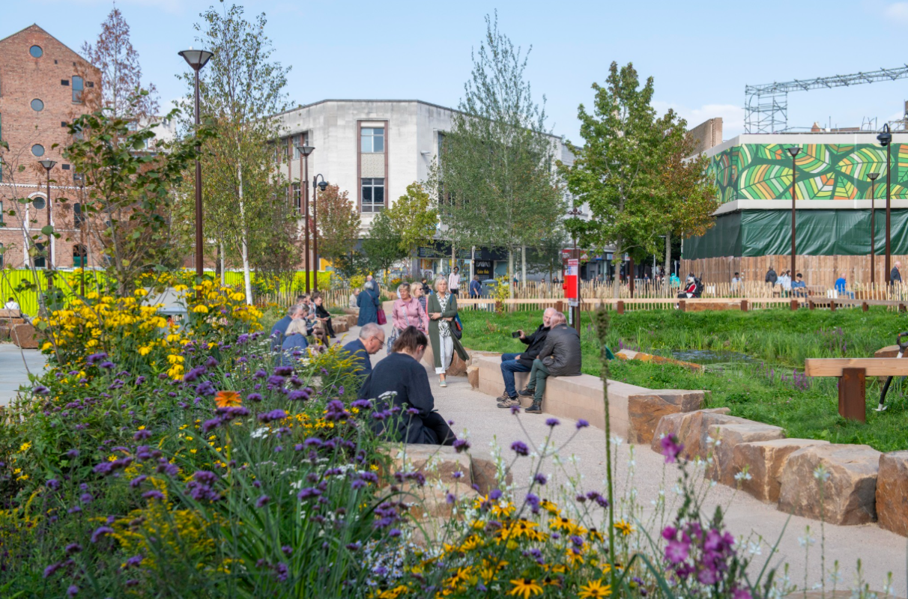

The Draft Vision
Tuesday 7th April 2026

Slide 2
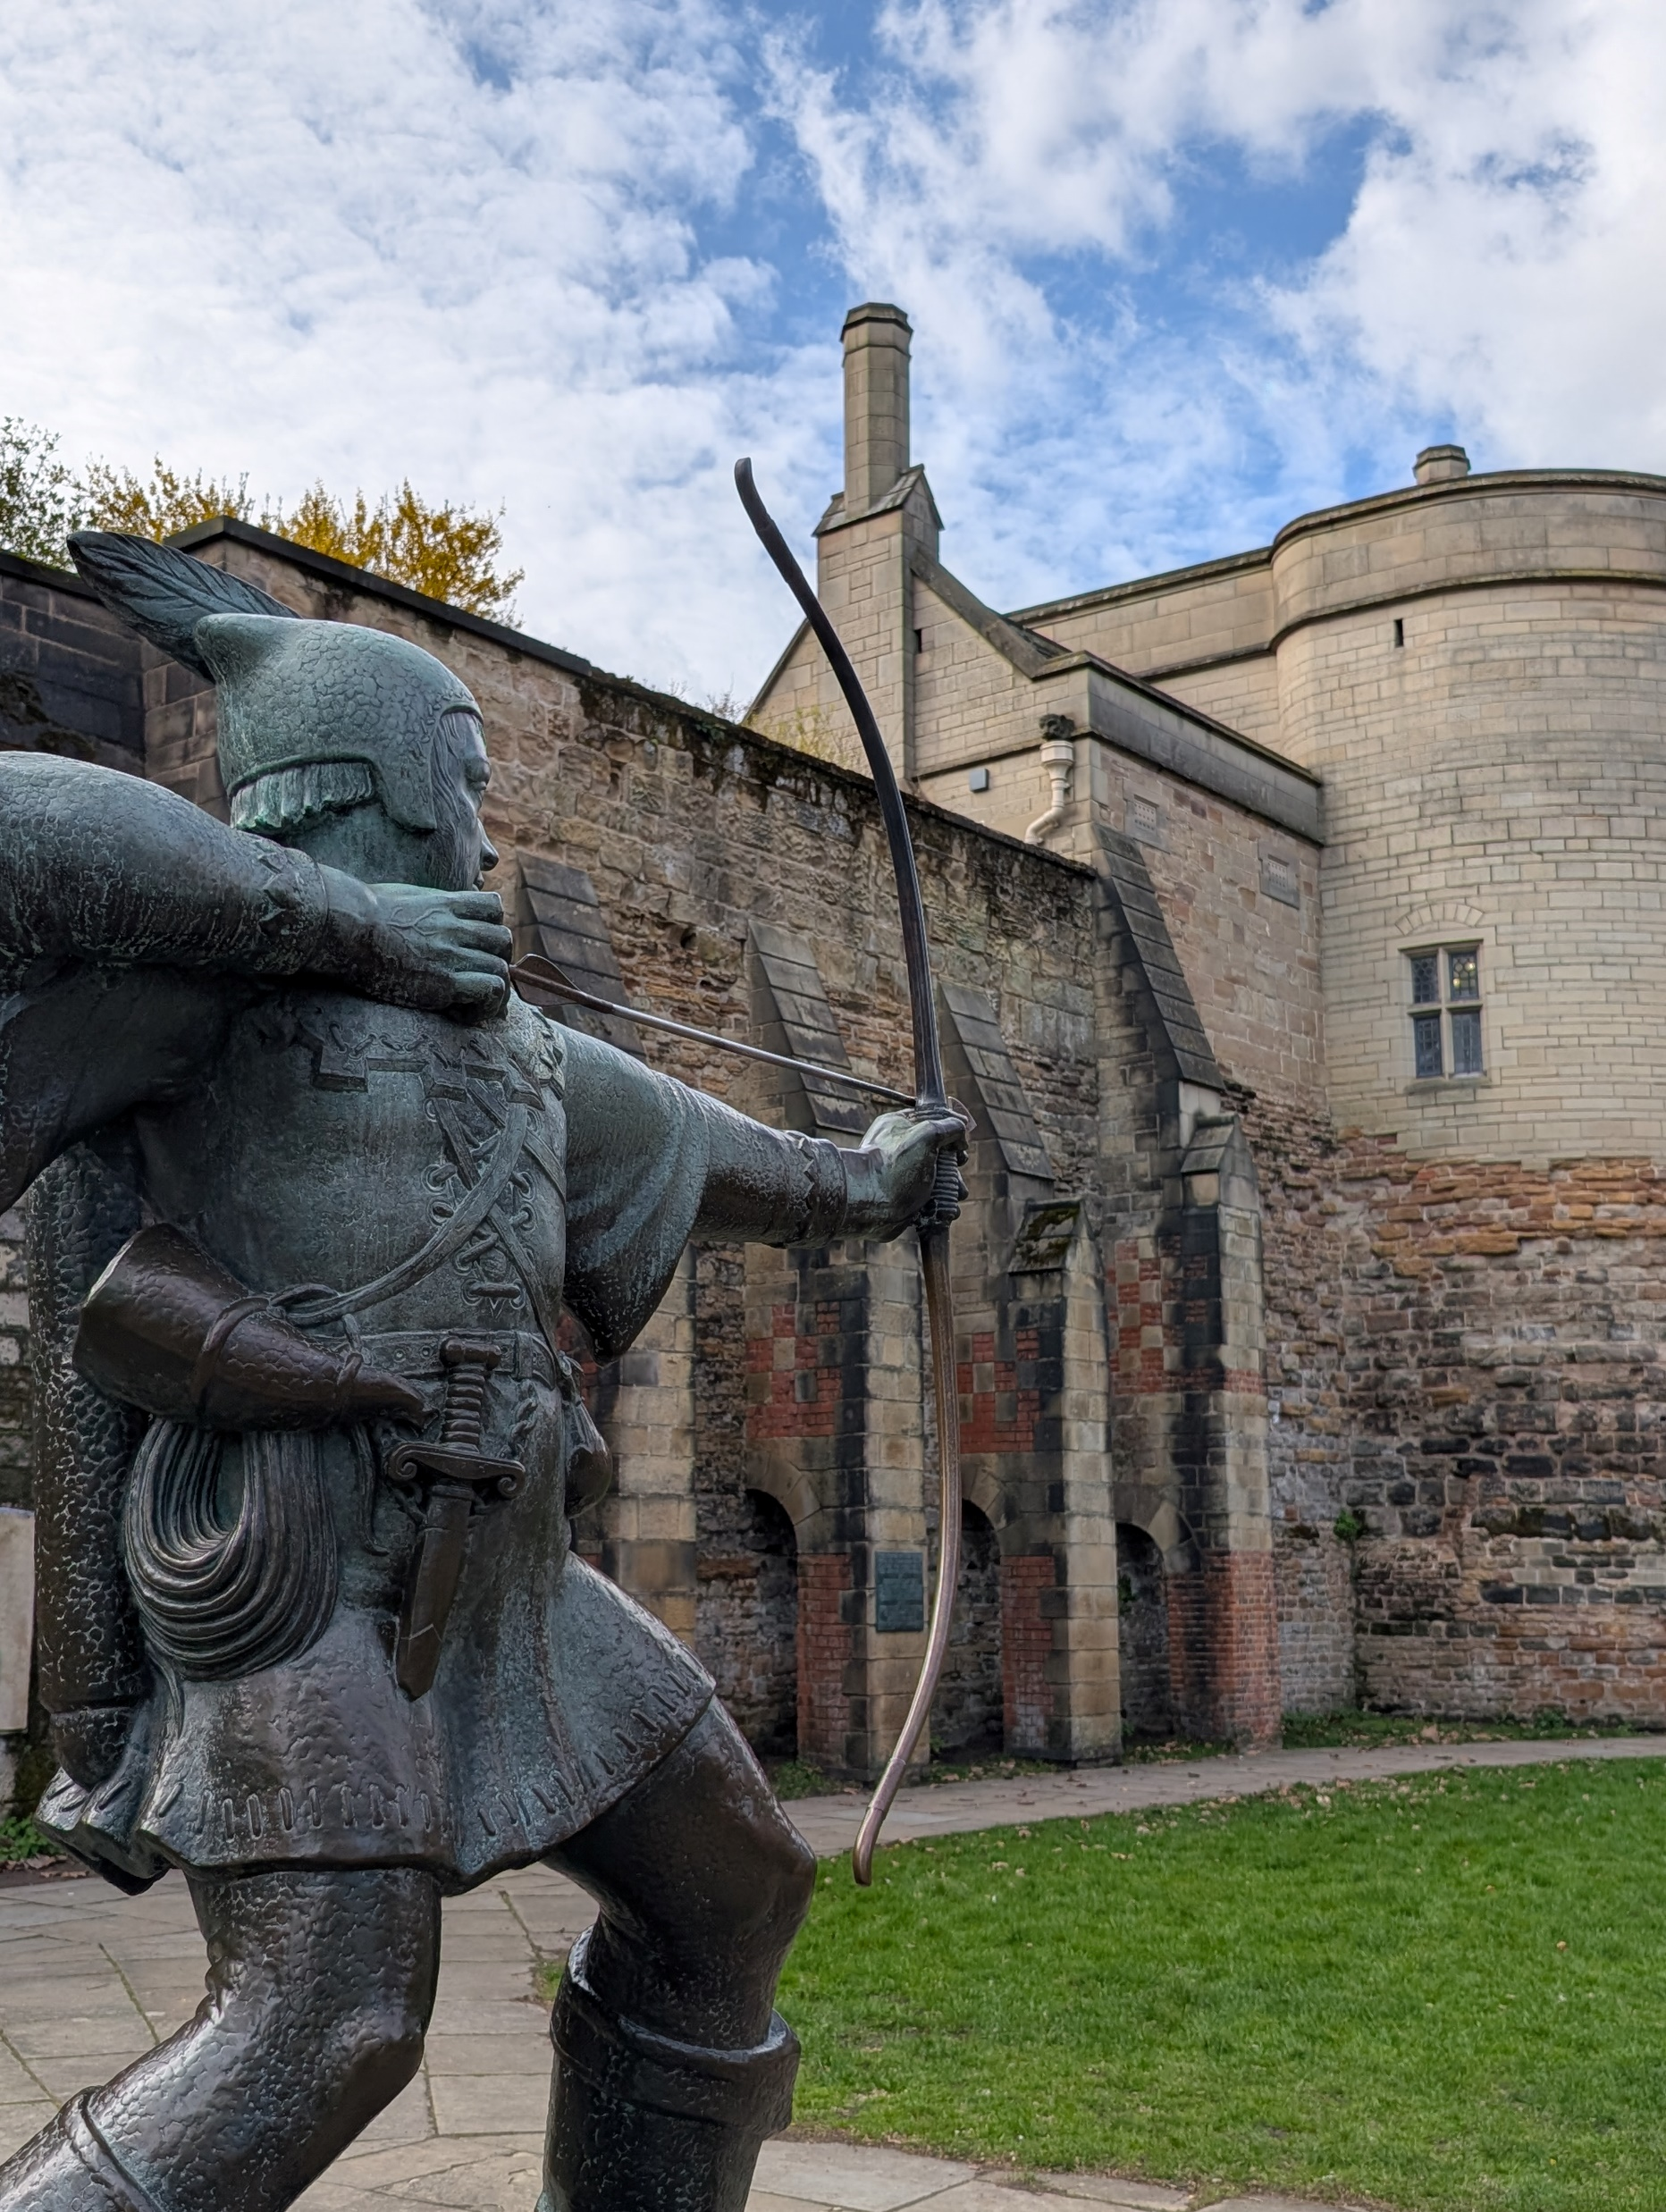
Purpose of the Vision
The new Nottingham Vision will set out how our city centre and surrounding neighbourhoods develop and grow, to meet the future needs of residents and businesses alike.
It will act as a route map to the future so that development is coordinated and joined-up.
It will identify major opportunities to attract future investment to build new homes, grow businesses and improve infrastructure.

Slide 3
The Draft Vision

Slide 4
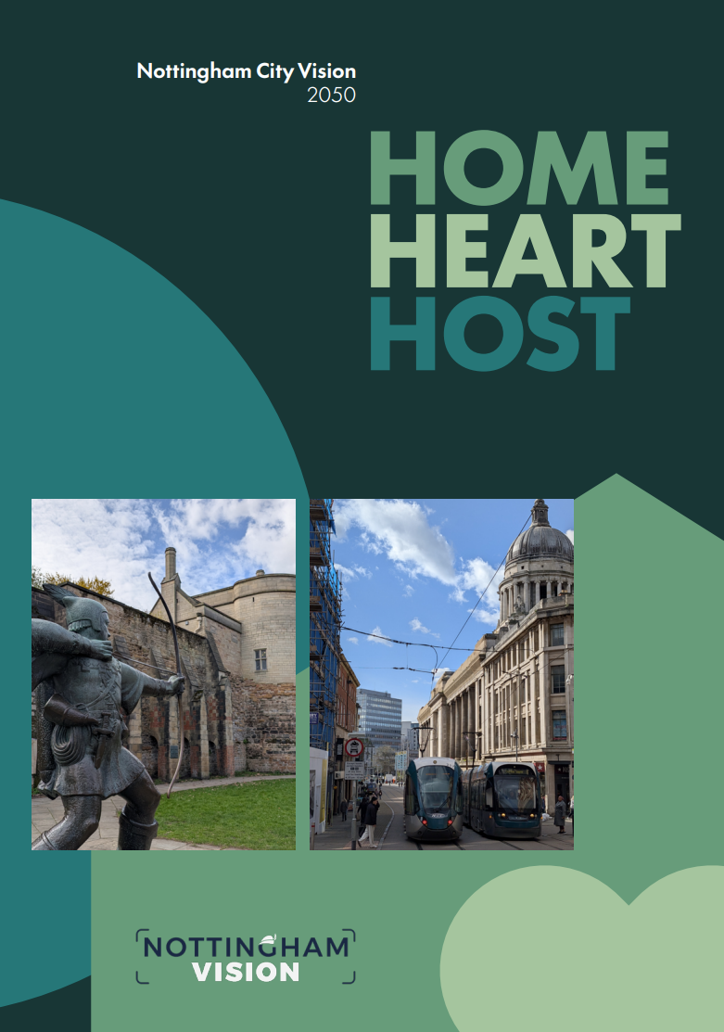
The Vision
Home, Heart and Host
At the centre of this Vision is a clear, distinctive proposition. By 2050, Nottingham will be the proud Home of diverse and healthy communities, the independent Heart of a dynamic region, and the Host of opportunity, global culture and sport.
This is our statement of intent. It underpins the entire Vision and sets out how Nottingham will look and feel, the role it will play, and the values it will uphold. It defines the energy the city will project, and provides the foundation for the delivery of the Vision.

Slide 5
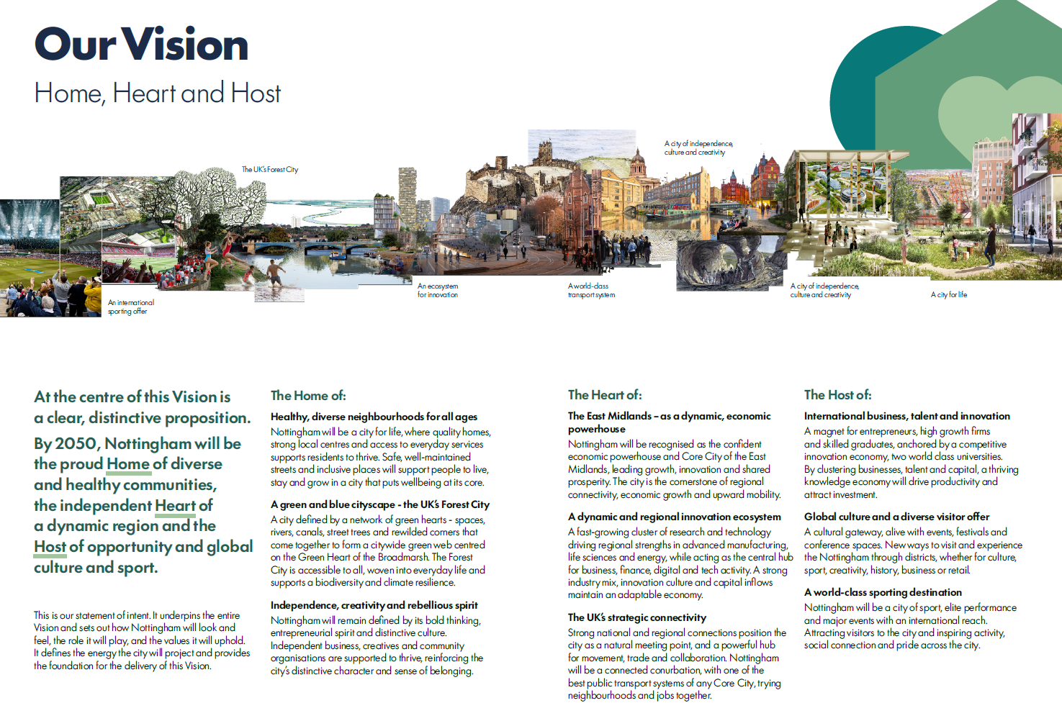

Slide 6
Ten Bold Ideas for Nottingham
Elevating beyond business as usual
Taken together, the Ten Bold Ideas present a cohesive and credible transformation strategy for Nottingham to be able to realise the Vision - economically, socially, culturally, spatially and environmentally.
They reflect the things Nottingham is already good at and build on projects that are already happening – but they are also visionary, and will take us one step further.
They strike a balance across ‘Home, Heart and Host’, giving the vision purpose, economic momentum and emotional resonance; they feel uniquely Nottingham.
Crucially, the bold ideas fit together, with each one strengthening the others.
The bold ideas are part of a system of change in the city, rather than just being isolated projects.

Slide 7
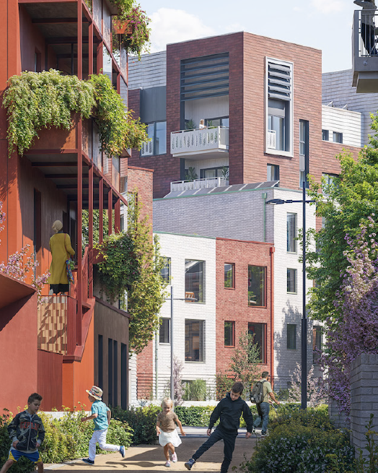
Idea one: Homes in the Heart
HOME
More homes. Better neighbourhoods. A more vibrant city centre.
What: Accelerating delivery of more and better housing, shaping a new generation of compact, walkable neighbourhoods. Why: A strong residential population will boost the city centre economy, improve neighbourhood environments, and help deliver the city’s target in sustainable locations. By 2030 we will have established funding for infrastructure and delivered progress on key sites, including Broad Marsh. By 2050 we will have delivered the target of 27,000 homes, and transformed key neighbourhoods.

Slide 8
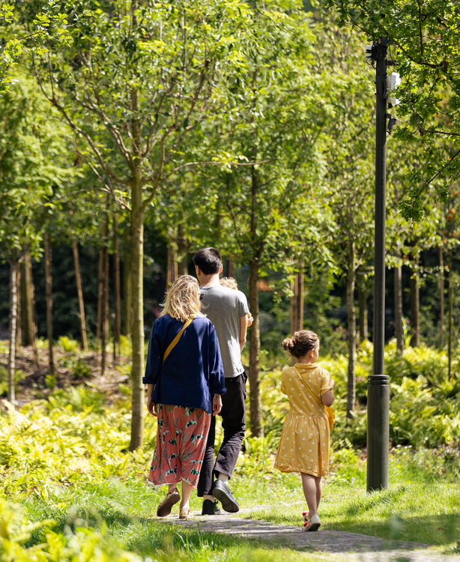
Idea two: Children’s Forest
HOME
A national exemplar. Urban nature, learning and wellbeing as one.
What: Putting children and young people at the heart of the UK’s first Forest City, creating a constellation of rewilded spaces around the city where play is key. Why: Improving everyday access to nature will tackle inequalities, strengthen biodiversity, and provide Nottingham with a distinct asset. By 2030 we will have identified delivery routes for anchor projects, and delivered quick-win greening in the Old Market Square and Sneinton Market. By 2050 we will have delivered the Childrens Forest, and established a long-term stewardship model.

Slide 9
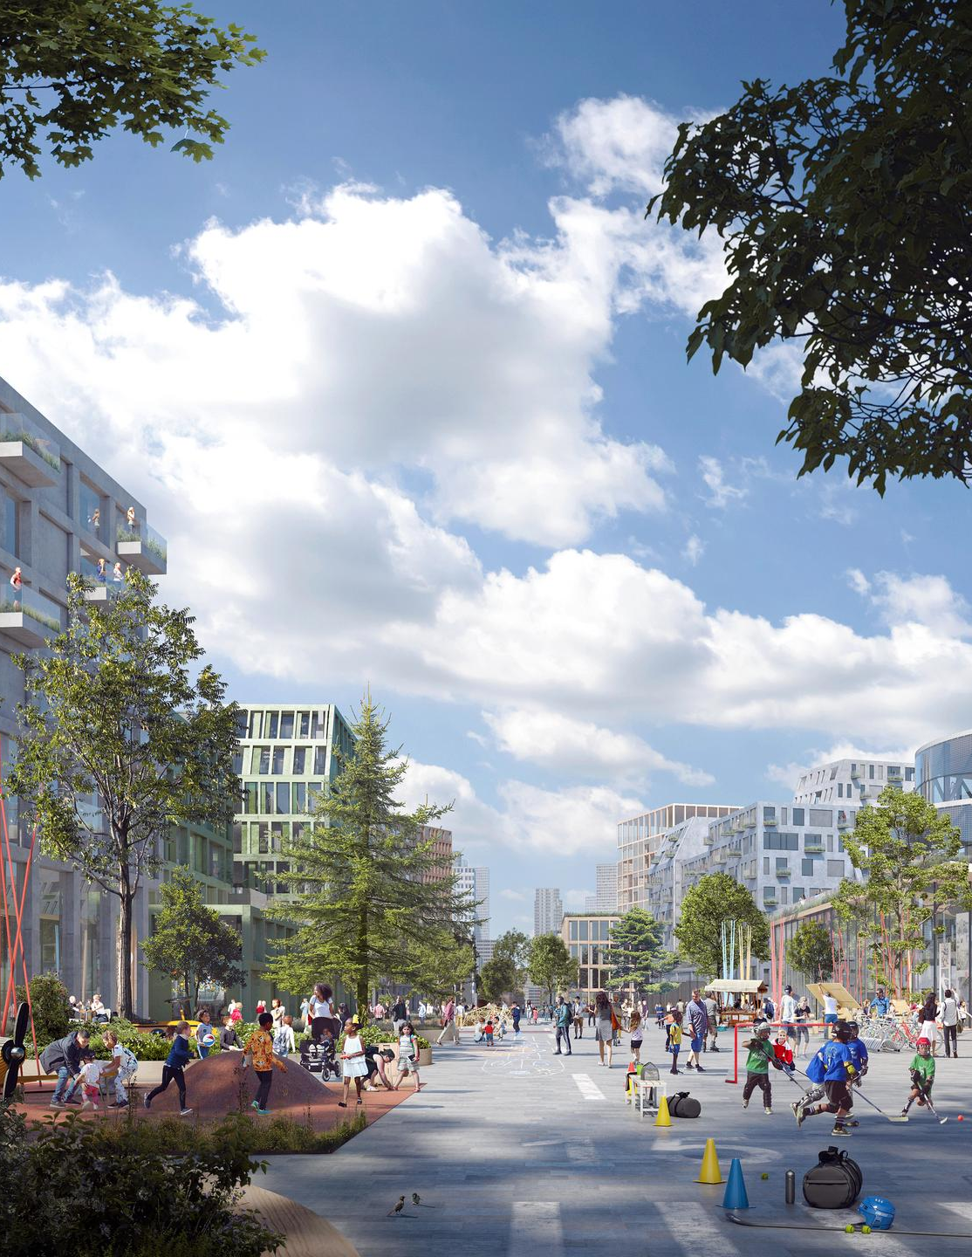
Idea three: Restitching Nottingham
HOME
Upgraded active travel. Expanding the tram. Our citywide Green Grid.
What: Upgrading routes through the City Centre as a Green Grid, encouraging active travel between our key economic, cultural and environmental assets, and extending the city’s tram network. Why: Tackling perceptions of environmental decline in the city, making movement easier and feel safer, and improving connections to opportunity. By 2030 we will have delivered priority schemes as a proof of concept, and established the business case for tram extensions. By 2050 we will have delivered extensions to tram routes, and the Green Grid as a whole.

Slide 10
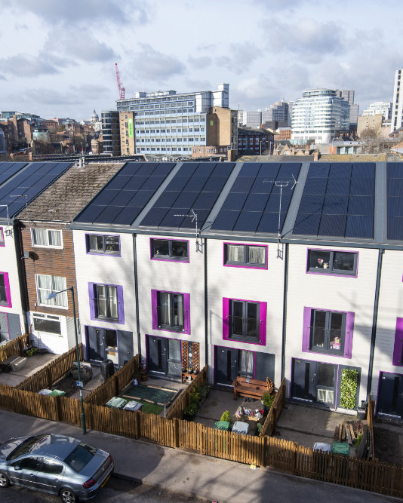
Idea four: Connected Energy City
HOME
Affordable and resilient. Zero carbon. Powered by innovation and place.
What: Renewal and expansion of the city’s clear energy assets, using regeneration to drive large scale building retrofit – invisible to most but essential for sustainable growth. Why: Building on Nottingham’s long standing clean energy legacy, driving growth and innovation, with lower costs and lower emissions. By 2030 we will have established a clear pipeline for retrofit, and connected the heat network to key sites such as Broad Marsh. By 2050 we will have significantly expanded the geographic scope of our zero carbon energy networks.

Slide 11
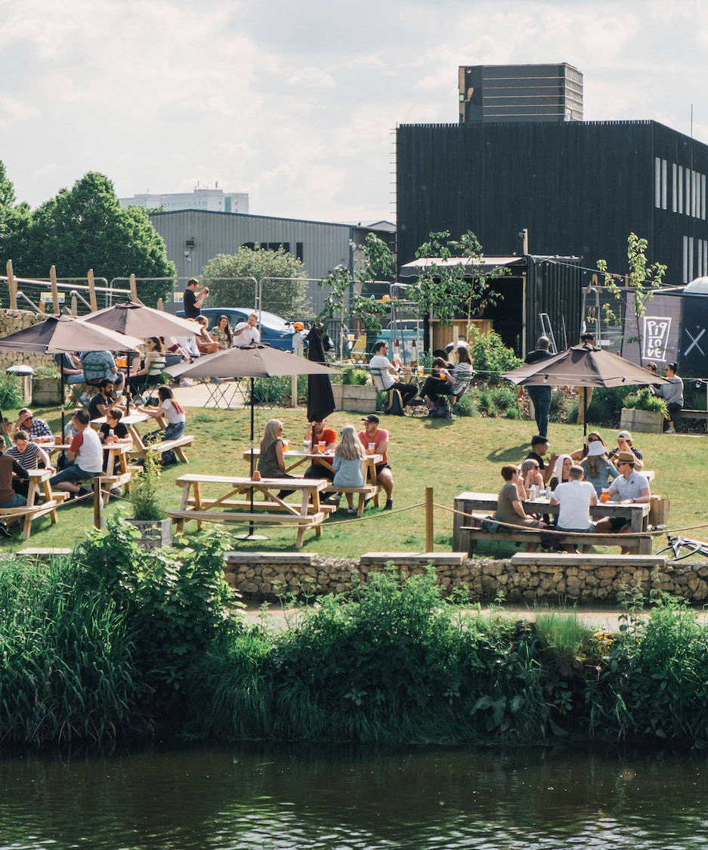
Idea five: Innovation Engine
HEART
Integrated. World class. A dynamic innovation ecosystem.
What: A clear focus for innovation, with the Canal Innovation Corridor as its anchor, linking Castle Meadow to the Island Quarter. This will also be supported by ‘Living Labs’, transforming vacant spaces into testbeds for new enterprise models. . Why: Nottingham has globally recognised universities and innovation assets, that should be primed for growth alongside exemplars like Eindhoven and Malmo. . By 2030 we will have established Living Lab demonstrators, and formed delivery partnerships for the wider ecosystem. By 2050 we will have seen clear, transformative growth in key sectors.

Slide 12
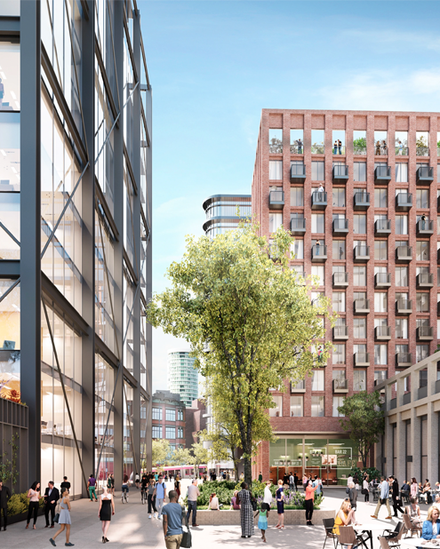
Idea six: Commercial District
HEART
Modern. Net zero. The commercial heart of the East Midlands.
What: A transformative programme to create a coherent, high-quality business district for the city – centred on Broad Marsh, Southside and the Canal Innovation Corridor. Why: There is clear unmet demand in Nottingham for Grade A office space, and also opportunities that can be created by better-clustering businesses. By 2030 we will have identified key sites and worked with promoters to bring forward a coordinated pipeline. By 2050 we will have fully built-out the Commercial District, tying it in to other Bold Ideas such as the Green Grid.

Slide 13
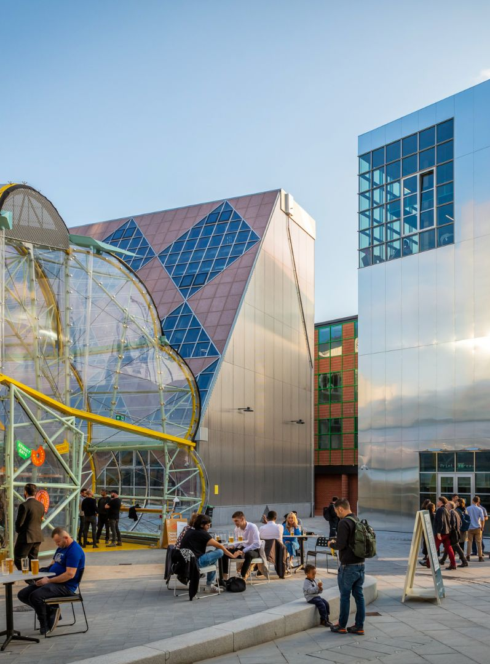
Idea seven: Small Business Innovation
HEART
Celebrated independents. Champions of creativity. A world-leading hub.
What: Creation of a dedicated Centre for Small Business Innovation – a global champion for innovation in the sector combining research, enterprise support, design thinking and networks. Why: Nottingham is one of the UK’s strongest creative and digital economies. Opportunities in these sectors will drive many of our key opportunities for growth, and this could be a global beacon. By 2030 we will have established a business case and delivery approach, with initial support programmes already in place. By 2050, Nottingham’s independents will be flourishing.

Slide 14
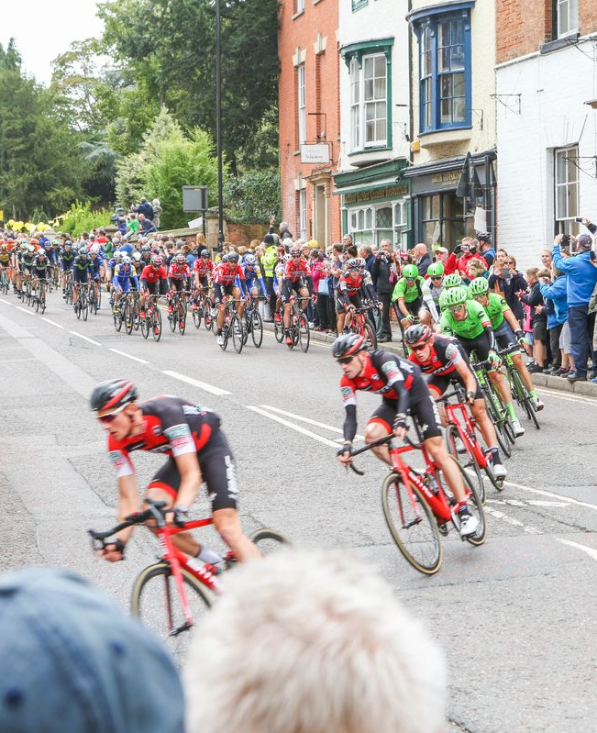
Idea eight: The Sports Corridor
HOST
Elite sport. Healthy lifestyles. Play and movement.
What: A coherent, high-quality urban district linking the city’s sports assets into the wider sporting cluster across southern Nottinghamshire. As well as promoting sport, streets and spaces will be designed around promoting healthy lifestyles.
Why: Nottingham has world-class sporting DNA, but its assets are not clearly connected. By 2030 we will have developed active travel links and gateways along London Road. By 2050 we will have implemented programmes that ensure Nottingham is recognised as a globally significant sporting city, both for residents and visitors.

Slide 15
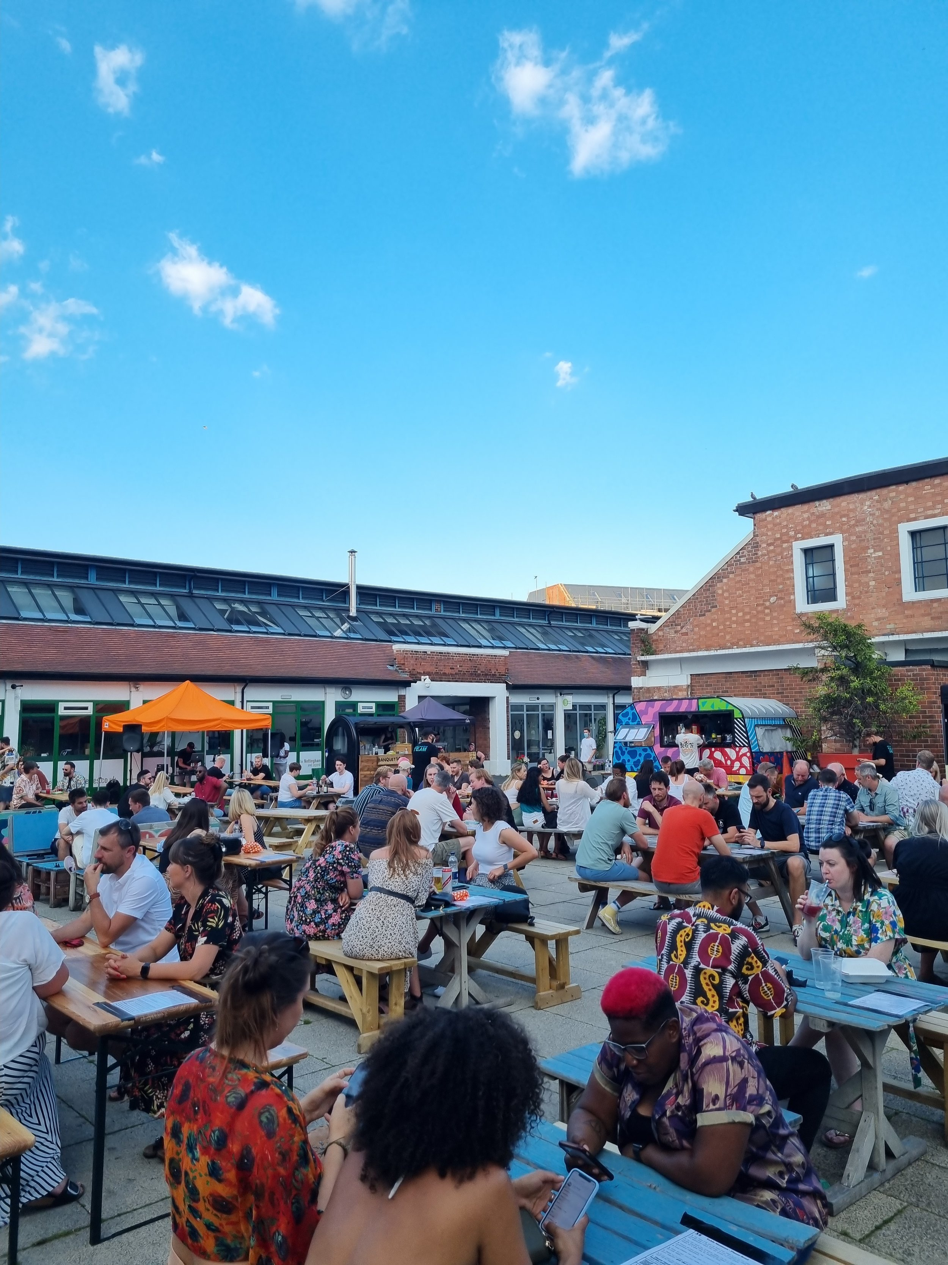
Idea nine: The Independent Mile
HOST
An active and vibrant retail district. Anchored by the Independent Mile.
What: A curated, branded walking route from Derby Road, through the Old Market Square and Hockley, to Sneinton Market. A complement to the ‘traditional’ north-south retail corridor in the city, with the two combining in strength with coordinated marketing.
Why: Nottingham has a strong independent retail sector, but it is disconnected and could do much more to facilitate the city’s overall offer. By 2030 we will have established the Independent Mile, a coordinated programme of events, and put branding and wayfinding in place. By 2050 the delivery of other Vision projects along the route will have resulted in coordinated transformation.

Slide 16
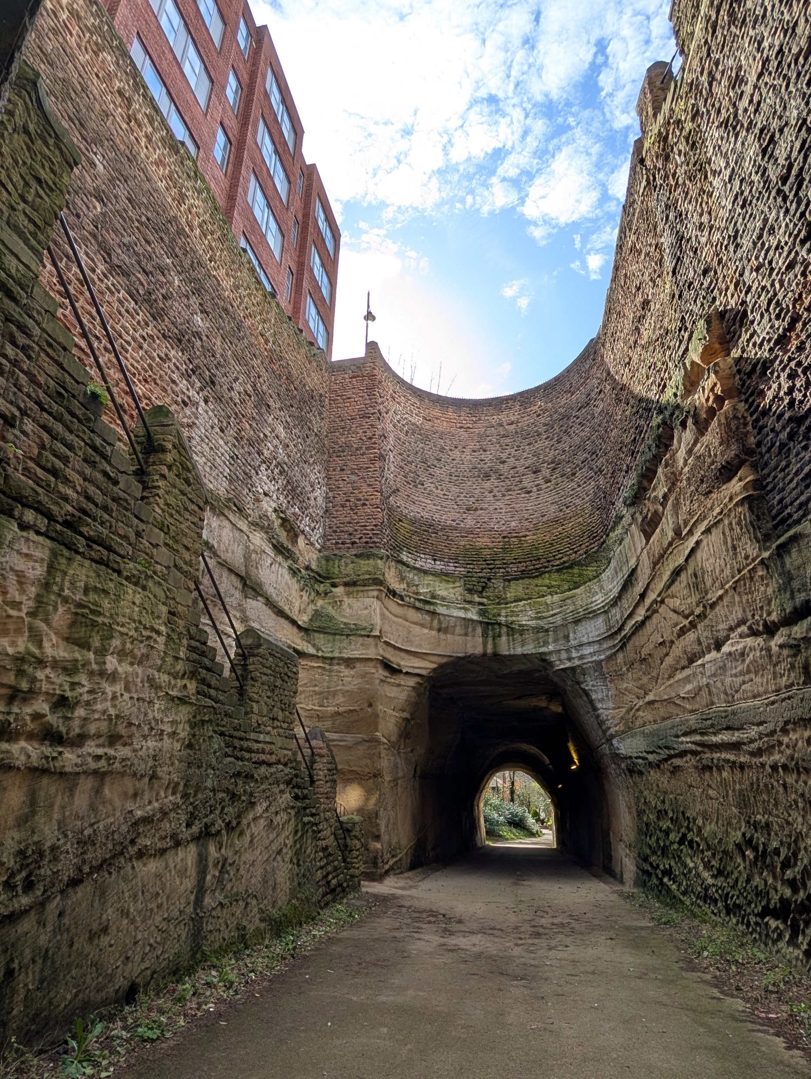
Idea ten: A City of Stories
HOST
Embracing rebel history. Celebrating our literary and cultural assets.
What: A curated, branded walking route from The Playhouse, past Nottingham Castle, to the Lace Market and Sneinton Market – a Cultural Spine tying the city’s key visitor attractions together.
Why: Nottingham has a rich history, with world-class cultural assets, but it does not have a cohesive story that ties these all together. By 2030 we will have established the Cultural Spine, a coordinated programme of events, and put branding and wayfinding in place. By 2050 the delivery of other Vision projects along the route will have resulted in coordinated transformation.

Slide 17
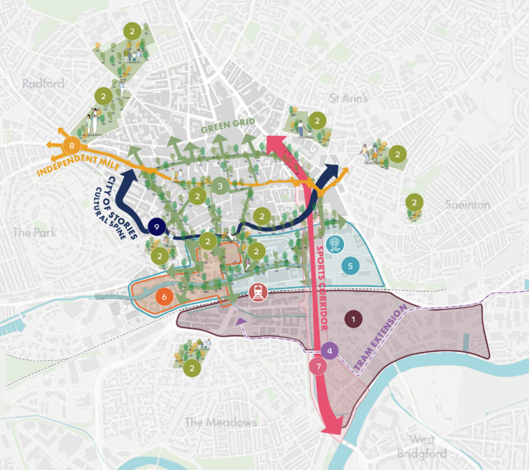
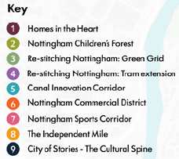
Spatial Plan
Where change will be focussed

Slide 18
Making it happen
Draft vision
The Vision is a shared narrative for guiding coordinated investment and regeneration in Nottingham.
The Vision has been designed to be specific and realistic, but also broad and adaptable, with the expectation that it will evolve over time.
The Vision serves as a foundation from which future initiatives and interventions can be developed, and acts as a framework to support collective action.
An accompanying Investment Plan will be developed, to set out the development opportunities and interventions.
We also propose a new city centre masterplan to further develop the Ten Bold Ideas, and set out how the projects will be brought forward spatially.

Slide 19
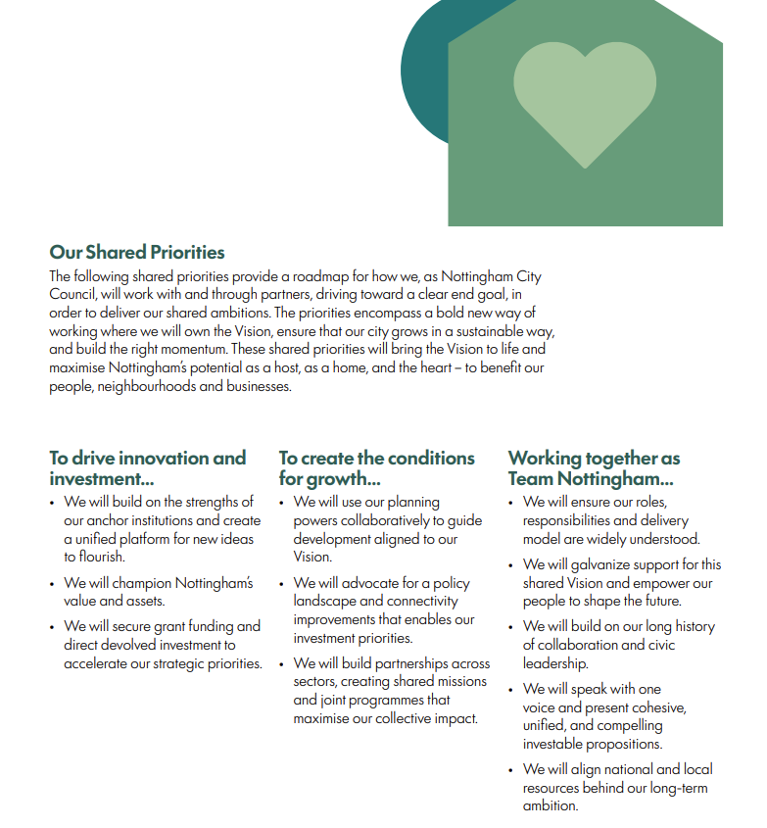
Making it happen
Draft vision
Next, we need to plan how we will deliver the investment opportunities and work with partners – ‘Team Nottingham’

