Slide 1
Nottingham City Council
Budget Consultation 2024/25

Slide 2
Why are we here today?
To explain the Council’s draft budget for next year, 2024/25
To stress that this is genuine consultation. Nothing is “set in stone”. We want to hear your views on the budget proposals.
To talk about the very tough and changing financial environment we are in and what the future holds for the council
To respond to your concerns, ideas and comments

Slide 3
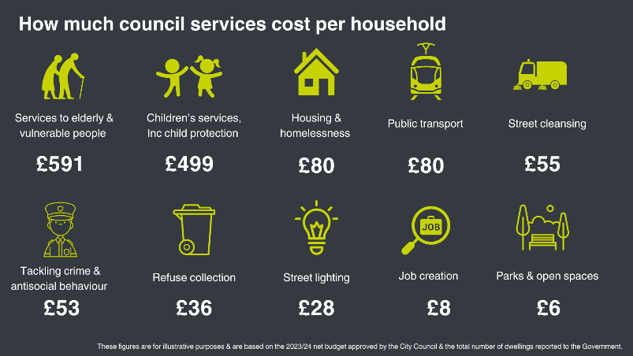
How we spend our budget
The council provides a wide range of services for local people. Some deliver statutory duties which councils have a legal duty to provide. Others are discretionary so councils can choose if and how they are provided.

Slide 4
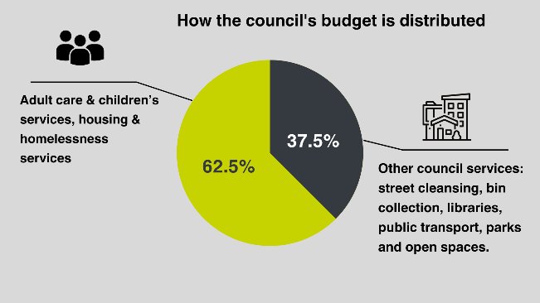
How do we spend our budget?
Nearly two-thirds of the total money we have to spend goes on adult social care, safeguarding children, homelessness prevention which leaves less money for other services
Adults - £87.079m / 33.3%; Children - £65.469m / 25.0%
Homelessness prevention - £10.784m / 4.2%

Slide 5
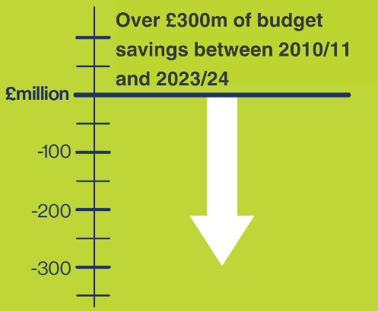
What we’ve done before
Since 2010 we have had to make over £300m cumulative budget savings
Previously, to balance the budget we have looked at things we can do to help maintain frontline services, such as:
Transforming our services
Efficiencies in all areas of the council
Reducing demand and increasing income
Holding down overheads
Modernising ways of working
Reducing council posts
Increasing income

Slide 6
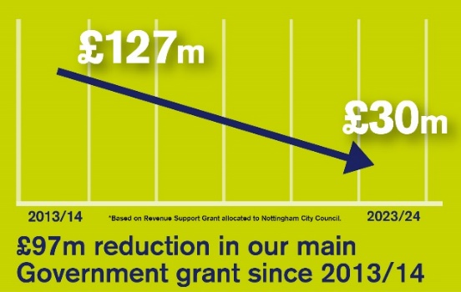
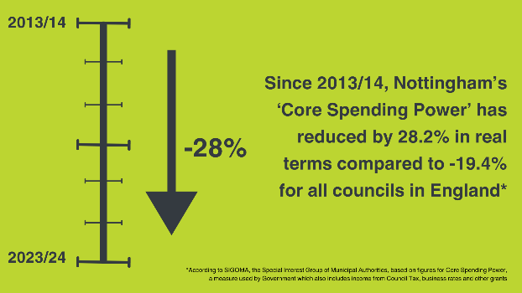
But every year it gets harder…

Slide 7
The council faces a £50m budget gap in 2024/25
This is due to issues facing many councils across the country including:
the cost of increased demand for adult care and children’s services
a rise in homelessness presentations
inflation and unfunded national pay increases
Past issues relating to the council’s financial governance have reduced our financial resilience and ability to draw on reserves.

Slide 8
Budget consultation
To bridge the large budget gap faced, difficult decisions have to be considered.
A wide range of proposals have been put forward by officers to:
manage demand
increase charges
reduce costs
reduce services to a statutory minimum and in some cases cease services and funding altogether.
These were discussed by Executive councillors on 19 December and are now subject to public consultation until 16 January

Slide 9
Budget proposals
A workforce reduction of over 500 full-time equivalent posts
Reviewing Library Service provision whilst maintaining a comprehensive and efficient service offer
Removing the council contribution towards Area Based Grants to the voluntary and charity sector and grants to arts organisations and the cultural sector
Reduce the Community Protection and Resident Development services ensuring duties relating to environmental enforcement and antisocial behaviour are met
Review the operation of community centres and seek to remove council subsidised grants

Slide 10
Budget proposals continued
Reduce all linkbus services to statutory minimum provision, remove Easylink and withdraw funding contribution to the Medilink service
Re-structure and reduce tiers and overall capacity in Adult Social Care Assessment function.
Close or sell the two existing in-house residential homes as a business and provide care through external providers as required.
Establish city wide baseline level for mechanical sweeping of the highway and other maintained areas of once every 12 weeks.
Introduce charges for garden waste collection.

Slide 11
Council Tax
We are proposing to raise Council Tax by 4.99% as permitted under Government proposals – made up of 2.99% Council Tax and a further 2% precept specifically towards Adult Social Care costs.
80% of Nottingham’s homes are in the two lowest Council Tax bands A and B – almost twice the national average – which means we are able to raise less through increasing Council Tax than many other councils.
However, due to changes in the way the Government funds councils, a much higher proportion of our funding is now expected to come from Council Tax

Slide 12
Next steps
Budget consultation takes place until 16 January. Have your say at:
www.nottinghamcity.gov.uk/engage-nottingham-hub
The draft Budget and Medium Term Financial Plan will be considered by the council’s Executive Board in February 2024
Final approval at the Full Council meeting on 26 February 2024

Slide 13
Thank you
Do you have any questions?

