Slide 1
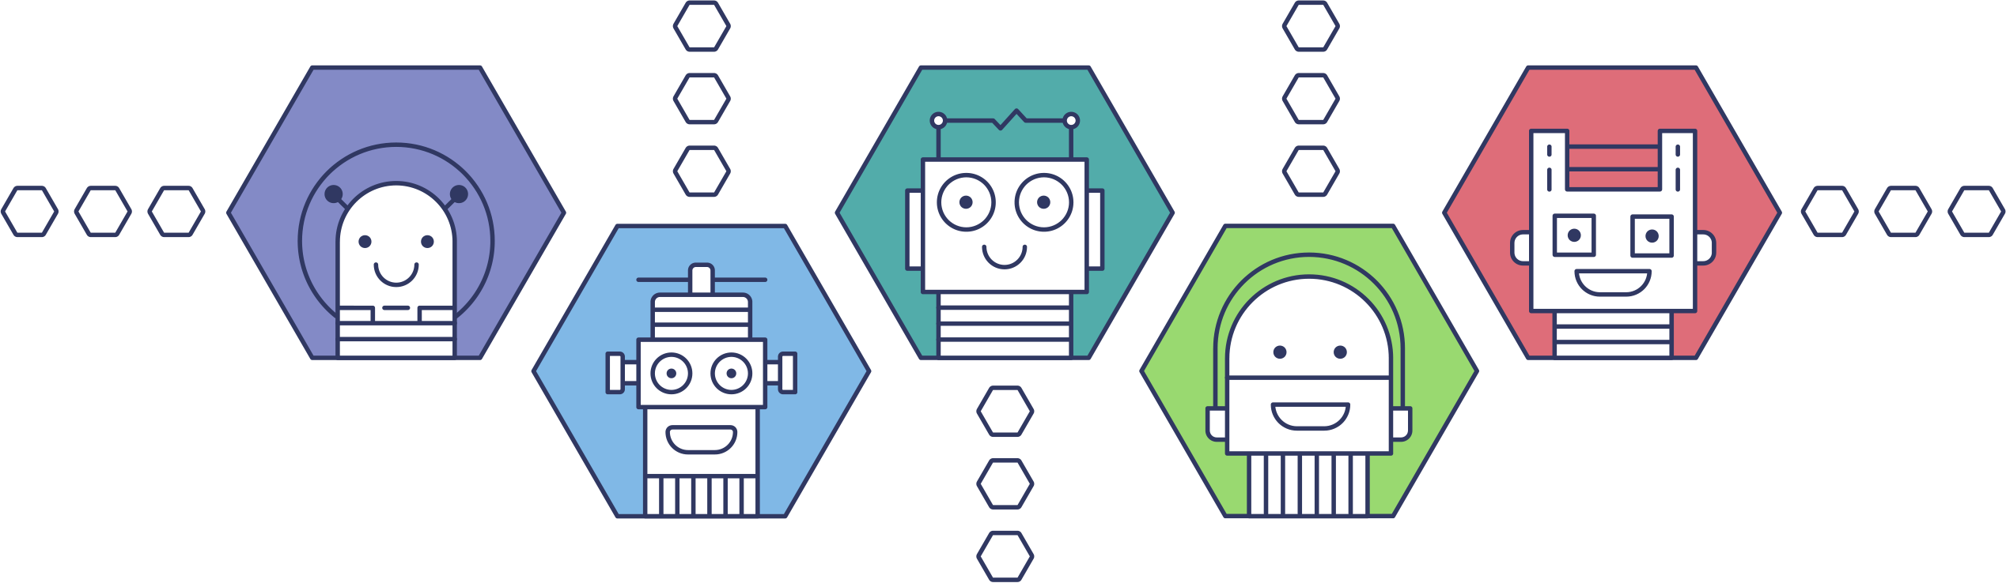
The Balanced System Pathway
An introduction to what it is and how to use it
Team

Slide 2
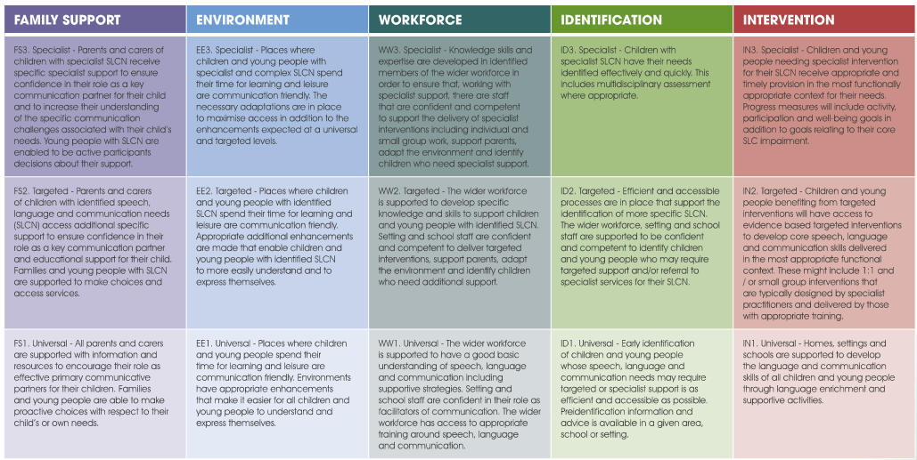
What are the Balanced System® High Level Outcomes?
15 outcomes are split across 3 levels (universal, targeted and specialist) across the Balanced System® Five Strands (family support, environment, workforce, identification and intervention)

Slide 3
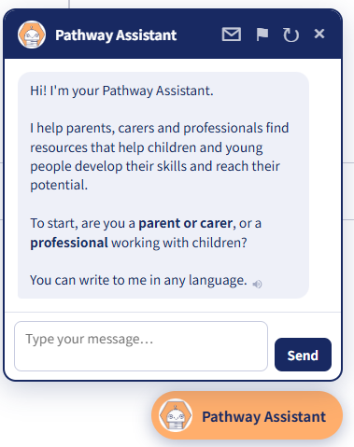
What is the Balanced System Pathway?
Single, online platform
Sharing information & resources to meet the Balanced System® High Level Outcomes
Outcome Led
What do you want help with?
Informs practitioners & families of local & national resources available relevant to speech, language and communication
Tool for practitioners & families to choose appropriate resources, support & information to create personalised pathways
Can be built into daily practice to ensure the right support can be accessed at the right time
Covers six age brackets
Baby, toddler, young child, primary, teenager and young
adult
Multiple language options
Primarily for speech, language and communication needs, but also includes physical activity, movement and participation skills
Pathway Assistant Chatbot to help

Slide 4
The Bigger Picture: Best Start in Life
The Balanced System Pathway supports core aspects of Nottingham City’s Best Start in Life Strategy
🤝 Strengthen family support
Roll out a national network of Best Start Family Hubs to integrate health, education, and parenting services.
💰 Expand early education access
Make early education and childcare more affordable and accessible, including support for funded hours.
🔍 Early SEND identification
Spot special educational needs and disabilities (SEND) early to provide timely support.
💡 Empower parents
Provide trusted, expert guidance via the Best Start in Life website to support parents as a child's first educator.
📈 Improve child development
Boost school readiness so that 75% of children reach a Good Level of Development (GLD) by 2028.
Nottingham City’s target is for 72.6% of children to reach a GLD by 2028.

Slide 5
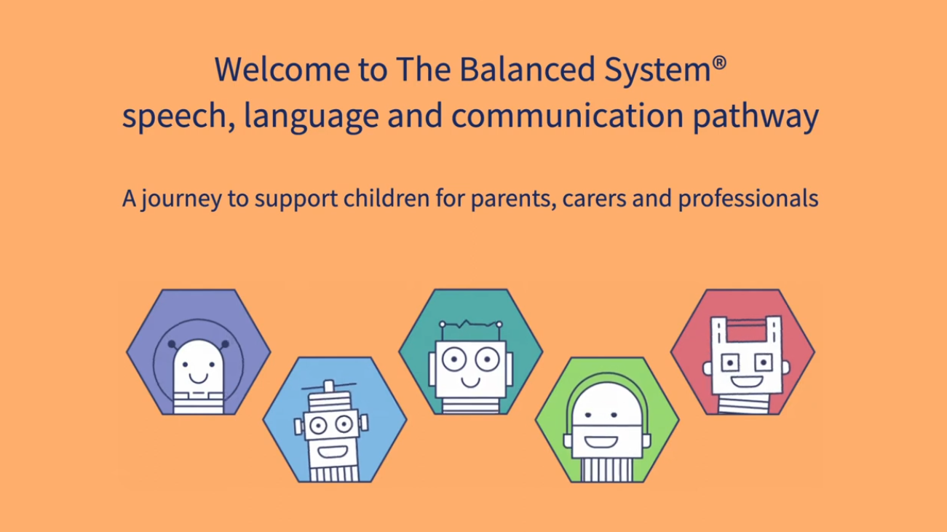
  Watch this video clip* for a great introduction to the Balanced System Pathway…
Notes:
* Please note that a new video is currently being produced as there have been some changes to the Pathway site since this video was produced, however it can still be shared as much of the content is the same.

Slide 6
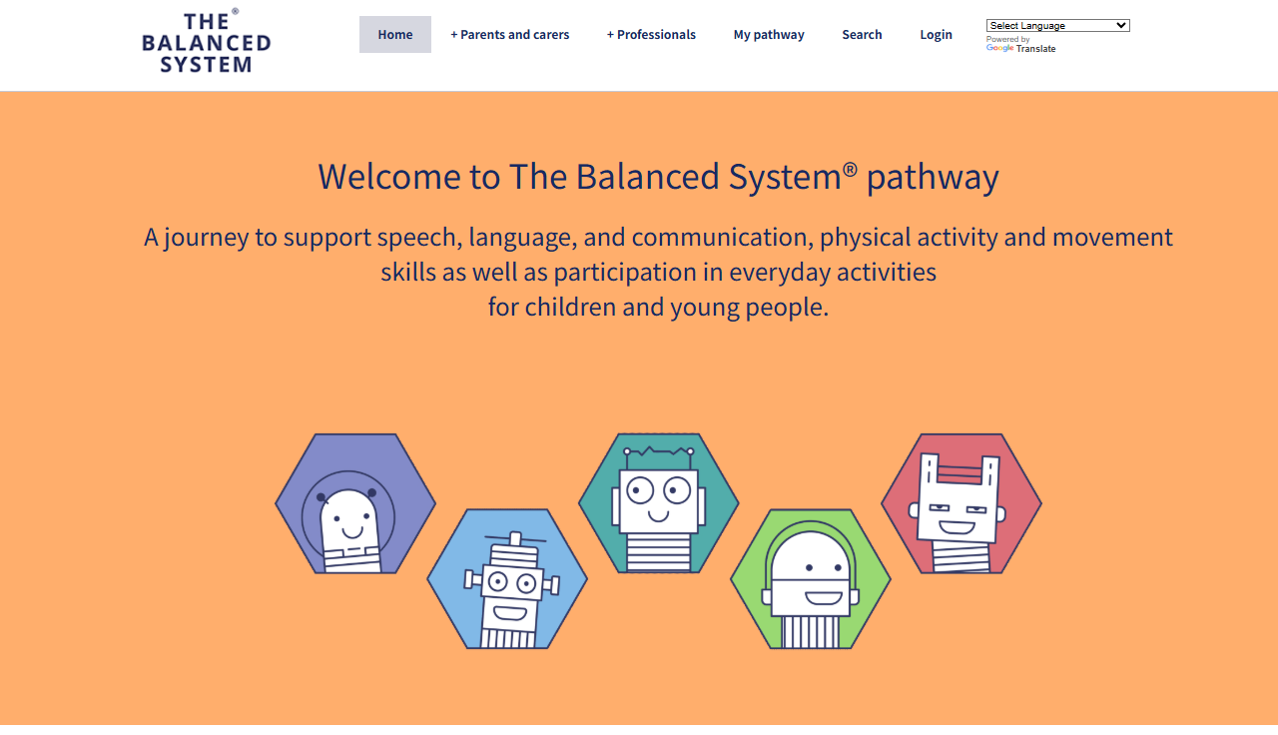
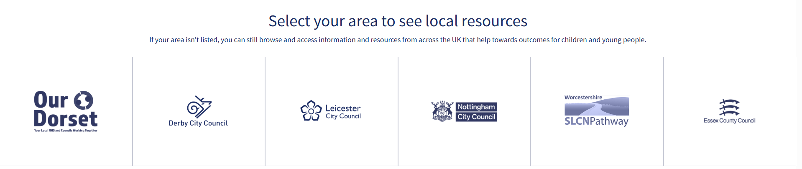
How to access the Balanced System Pathway
Visit https://pathway.thebalancedsystem.org/
Find Nottingham City Council
Scroll down and click on the logo
Create an Account
Accounts are free, register for an account or, if already created, log in

Slide 7
Once an account is created, you can create a Pathway!
Go to Login / Account from the Toolbar at the top
Select ‘Add new pathway’
Give your pathway a name (this may be the initials the child you’re supporting and/or a date, for example)
Click ‘Save and View’
Select whether you are a parent and carer or a professional from the toolbar at the top
Select the age of the child you’re seeking resources for
Select the strand of support you are wanting help for
View the local and national resources available
If you want to add them to your pathway, in the top right-hand corner of the resource, select Pathway: Add to
Click through as many strands or resources as are relevant to your search
Once complete, go to ‘My Pathway’ on the toolbar across the top and you will be able to see the resources you have clicked on under each strand. Your pathway will be saved on your account, but you can also download these resources as a PDF file, for your reference or to share with a family or colleague
  Please note that you can change the language you are viewing the Pathway in at any point by selecting your preferred language in the top right-hand corner of the screen

Slide 8

  Revisiting a Pathway you have already created
  Go back to Login / Account from the toolbar at the top
  Your previous pathways will be saved here, displayed by the name you gave them and the date they were created
  You can view or change them from this page
  Need help?
  If you need help navigating the Pathway or finding a particular resource, don’t forget you can always ask the Pathway Assistant Chatbot, which can be found in the bottom right-hand corner of the screen
The best way to get familiar with the Balanced System is to log in and have a play!
You can’t break it!

Slide 9
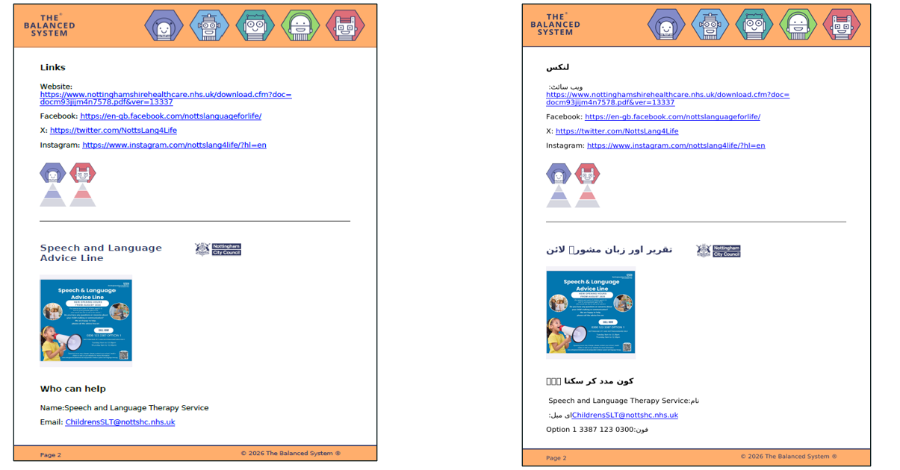
Case Study 1: An example from a Speech & Language Therapist Drop In
Background
Zinedin is 2 years and 2 months old and his parents attended a Drop In at Southglade Family Hub
Dad speaks to Zinedin in Urdu and Mum speaks to him in English. Parents are concerned about Zinedin’s spoken language, he only uses 5 words in Urdu & 5 words in English, Dad is thinking about stopping using Urdu with Zinedin
He is very sociable and there are no concerns about his understanding of language
Zinedin’s Pathway … in English and Urdu
Information section:
Bilingualism Advice
Information section - Resources that offer extra
support:
Home Talk – delivered by Speech and Language
Therapy Service
Services:
Speech and Language Therapy Advice Line
Activities:
Say what I see, Say what I would if I could &
Talk about what’s happening

Slide 10
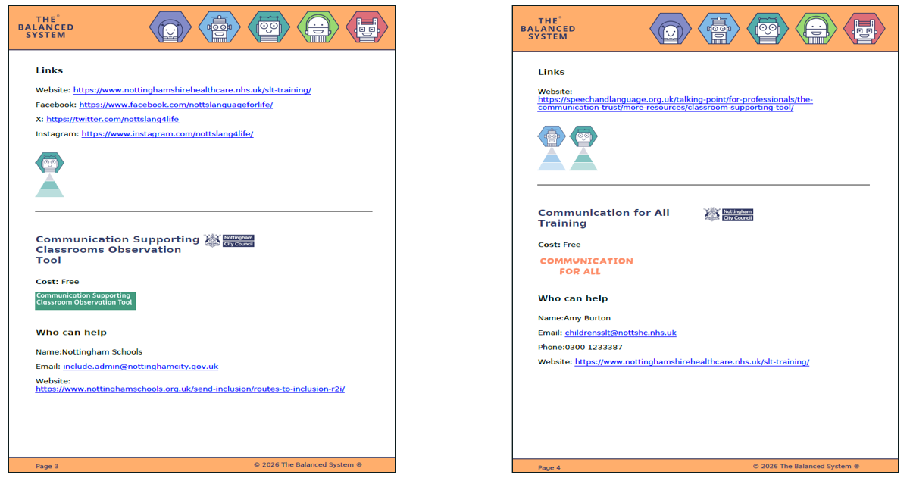
Case Study 2: Day Nursery Manager helping a staff member with their training & development
Background
Chloe is the Manager of a Day Nursery in Bulwell and has just completed staff member Tori’s appraisal
Tori mentioned that she wants to increase her knowledge of SLCN and be able to confidently share key messages with parents
There is a child due to start in a few weeks who is using Makaton signs and Tori will be their key worker
Tori has advised that she only knows the signs for please and thank you
Chloe used the Pathway to find out what is available to support Tori’s professional development
Chloe & Tori’s Pathway
Workforce section:
Local Offer:
  Language Lead Role
  Talking Matters Training
  Communication for All Training
  Communication Supporting Classrooms Observation
  Tool
Interventions:
Local Offer:
  Notts Top Tips for Communication (Notts Year of
  Communication)

Slide 11
A Practical Exercise
Scenario A
You are a practitioner working in Nottingham City with a group of toddlers and would like to develop your knowledge and skills around typical speech and language development. What resources can you find available to you, through the Balanced System Pathway? (Use the professional tab)
Scenario B
Think about a family or child that you work with
How you use the Pathway to support them?
Can you have a go at creating a Pathway with this family in mind?

Slide 12
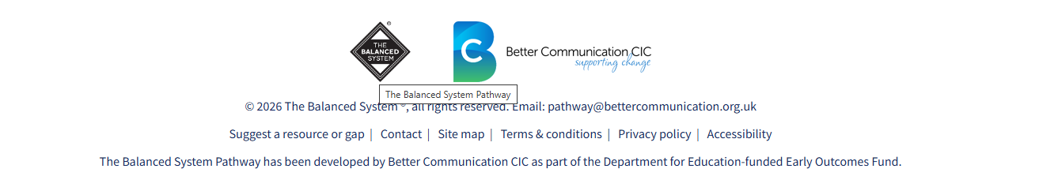
Next Steps...
* The Pathway will be refreshed termly to ensure resources are current
* Collectively, we have the power to build on making this a fantastic resource. If you know of a resource that you think could be added, or needs updating, please click on the ‘Suggest a resource or gap’ at the bottom of any page on the Pathway
* Share this information with anyone who you feel may benefit, this is a great local resource for parents and carers and professionals and it’s here to stay! Get familiar with it and use it, remember, you can’t break it!
* For further support
* If you are in a Setting, please contact your Support Worker in the first instance
* Alternatively, please contact max.dahle@nottinghamcity.gov.uk

